Slide 1
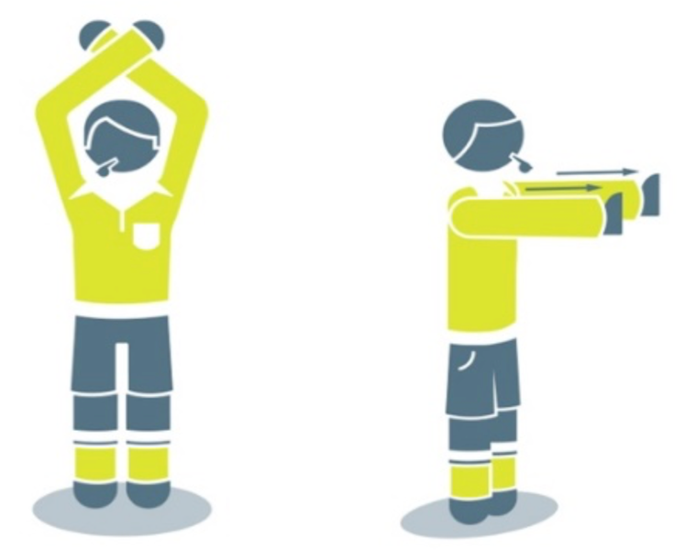
Law Implementations
LAWS OF THE GAME:
All matches will be played in accordance with the FIFA Laws of the Game.
Law 3.10 (Team Captain) Only The Captains- Protocol
The following procedure will apply:
The referee can initiate the ‘only the captain’ protocol at any stage, but it is most likely to be used following major decisions and to prevent major confrontations
The referee will blow the whistle and initiate the ‘only the captain’ protocol by using the following new signal:
Raising both arms above their head and crossing them at the wrists
Uncrossing their arms and moving them in front of their body with their palms open in a forward pushing motion to indicate that the players must not approach
Move away from the players to create zone ~4m – only the captain can enter this zone
After a brief explanation, the captain should be given a few seconds to explain the decision to their team
Notes:
Only The Captain
Opportunity for the referee to provide an explanation of contested decisions in the match
Does NOT replace cautions for dissent
Only the captain can approach the referee in a respectful manner when invited to do so
Goal is to have stronger cooperation and communication between captains and referees to instil higher levels of fairness and mutual respect.
Objectives
1. Improve the Image of the Game
Prevent mobbing of officials
2. Improve cooperation between the captain and the referee
Offer an uninterrupted line of dialogue
Referees give information to the captain on key decisions
3. Increase respect between the teams and the referee
Decrease in the number of yellow cards issued for dissent

Slide 2
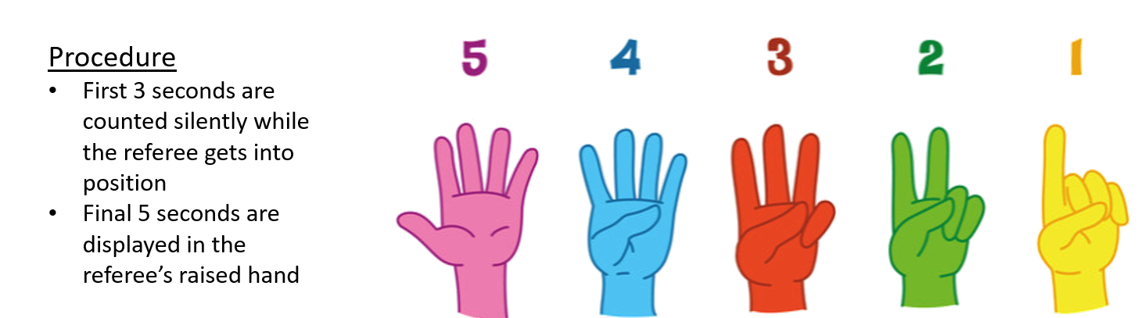
Law Implementations
Law 8.2 Dropped Ball:
If the ball is outside the penalty area when play is stopped, it is dropped for the team that had, or would have gained possession, if this is clear to the referee; otherwise, it is dropped for the team that last touched it. The ball is dropped at its position when play was stopped.
Law 12.2 If a goalkeeper holds the ball for longer than eight seconds (with the referee using a visual five-second countdown), a corner kick will be awarded to the opposing team (rather than an indirect free kick if a goalkeeper holds the ball for more than six seconds, as per the current Laws).

